Slide 1
Time Well Invested
The power of long-term compounding returns
AJ Bell - May 2025

Slide 2
Cautionary statement
This presentation contains certain statements that are, or may be deemed to be, forward-looking. Phrases such as "aim", "plan", "intend", “should”, "anticipate", "well-placed", "believe", "estimate", "expect", "target", "consider" and similar expressions are generally intended to identify forward-looking statements. Forward-looking statements are prospective in nature and are not based on historical facts, but rather on current expectations of the Company about future events, and involve risks and uncertainties because they relate to events and depend on circumstances that will occur in the future. Any forward-looking statement is based on information available to the Company as of the date of the statement, it can give no assurance that these expectations will prove to be correct. There are a number of factors that could cause actual results and developments to differ materially from those expressed or implied by the forward-looking statements. Forward-looking statements should therefore be construed in the light of such factors. You are cautioned not to place undue reliance on any forward-looking statements, which speak only as of the date made. All written or oral forward-looking statements attributable to the Company are qualified by this caution. Other than in accordance with legal and regulatory obligations, the Company undertakes no obligation to publicly update or revise any forward-looking statement, whether as a result of new information, future events or otherwise.
Past performance is not a reliable indicator of future results. The value of investments can fall as well as rise and you may get back less than you invested when you decide to sell your investments. It is strongly recommended you take independent financial advice before making any investment or financial decision.
This presentation is solely for information purposes only and any views contained in it must not be construed as investment or tax advice or a recommendation to buy, sell or take any action in relation to any investment. No representation or warranty, express or implied, is given by any person as to the accuracy or completeness of the presentation and no responsibility or liability is accepted for the accuracy or sufficiency of any of the information it contains or for any errors, omissions or misstatements, negligent or otherwise. Any views and opinions, whilst given in good faith, are subject to change without notice.

Slide 3
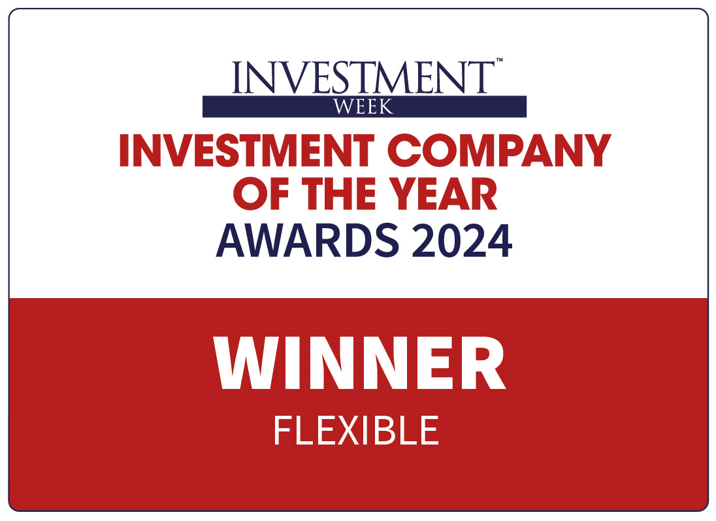
Caledonia
We are a long-term equity investor
Self-managed investment company
Net assets of £2.9 billion
Established by the Cayzer family
History dates from late 1800s
Objective of preserving and growing capital and income in real terms over the long-term
Targeting long-term compounding real returns CPIH +3% to +6%
Progressive dividend policy
Successful track record Strong consistent long term NAV growth
58 consecutive years of dividend increases
NAV Growth
NAV total return growth since 2005
Dividend Growth
Annual dividend / share (p)
+100p special
+175p special
Past performance is not a reliable indicator of future results
Caledonia financial information at 31 March 2025

Slide 4
Time well invested
We invest time to make confident, well balanced compounding investments
Our long-term strategy and evergreen balance sheet underpin our investment performance, enabling us to look through short-term market cycles, capitalise on fundamental opportunities and harness the power of compounding
Team
We have a team of experts, focused on making carefully considered long-term investments; free from benchmark limitations
Opportunity
Our investment strategies focus on attractive markets allowing our team to develop high-quality opportunities
Alignment
We invest our balance sheet, with interests wholly aligned with shareholders
Past performance is not a reliable indicator of future results
Caledonia financial information at 31 March 2025

Slide 5
The power of long-term compounding returns
802% return vs.178% return for FTSE All-Share¹
Hill & Smith plc
Market cap: £1.4bn¹¹
Leading provider of sustainable infrastructure products and services
First invested: Aug 2011
Holding value: £35.6m
Company A (Total Return Indexed to 100)
Past performance is not indicative of future results
Caledonia financial information at 31 March 2025
¹ As at 31 March 2025
Data source: Bloomberg (HILS LN, ASX Index Cumulative Total Return Gross. Caledonia first investment August 2011)

Slide 6
We are driven by fundamentals
We buy to hold, investing in high quality companies that have the potential to generate exceptional long-term value
At its core, our investment strategy focuses on companies with the following key characteristics:
Strong market position and fundamentals
Attractive underlying markets
Well managed with strong alignment
Across three investment pools
33%
NAV
30%
NAV
31%
NAV
Public Companies Strategic Allocation: 30%-40%
Private Capital Strategic Allocation: 25%-35%
Funds Strategic Allocation: 25%-35%
Global portfolio of c.30 companies across two strategies – Capital and income
Returns of 8.4% p.a. over 10 years
Direct investments in high quality, UK mid-market private companies
Portfolio of up to 10 companies
Returns of 12.4% p.a. over 10 years
Proven private equity managers in North American and Asia
Portfolio of >600 companies
Returns of 13.3% p.a. over 10 years
Past performance is not indicative of future results
Caledonia financial information at 31 March 2025
Notes:
On this slide the narrative would expand on what we mean for each of the characteristics:
Strong market position and fundaments - Strong customer base, Growing demand for products, Sustainable competitive advantage, multiple levers for growth, increases in revenue growth, with good profit margins, positive sustainable cash flows and healthy balance sheet etc.

Slide 7
Public Companies
Watsco: Distributor of air conditioning, heating and refrigeration equipment (largest in North America)
Strong market position and fundamentals
Market leader with strong compounding of earnings
Significant investment in technology platform – supports market share growth and improves margins
Attractive underlying markets
Product necessity
Highly fragmented $60bn+ distribution industry with high barriers to entry
Attractive as a buyer of smaller distributors
Well managed with strong alignment
Entrepreneurial culture
Decentralised
Differentiated ownership culture
Past performance is not a reliable indicator of future results
Caledonia financial information at 31 March 2025

Slide 8
Public Companies (cont’d)
Watsco: 25% annualised total return since first investment
Cost¹: £24m
31 March 2025 Value: £77m
(% NAV): 2.6%
Initial investment ($146)
Performance:​²
Revenue +77% from $4.3bn to $7.6bn
EBIT margins +210bps to 10.3%
Since initial investment, share price > tripled – market cap $20.53bn³
25% annualised return (£)
Mar 25
Past performance is not a reliable indicator of future results
Caledonia financial information at 31 March 2025
¹ Weighted average across Capital and Income portfolios
² From December 2017 to March 2025
³ As at 31 March 2025
Data source: Bloomberg WSO NYSE. Caledonia first investment February 2017

Slide 9
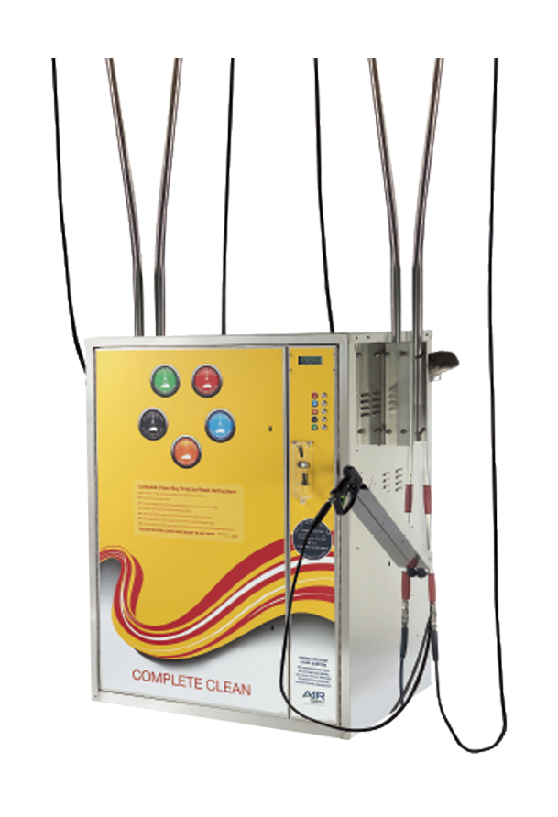
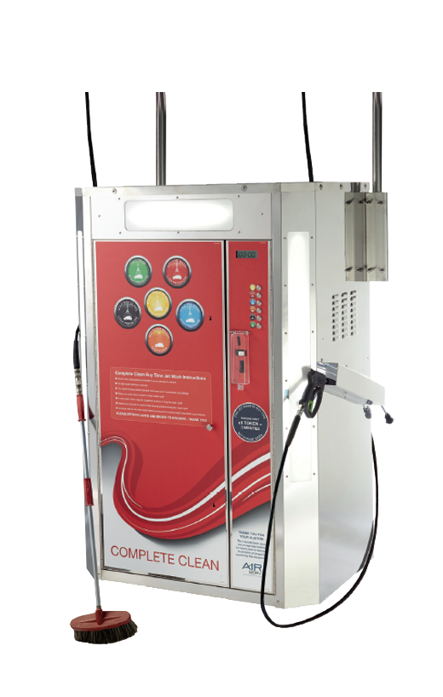
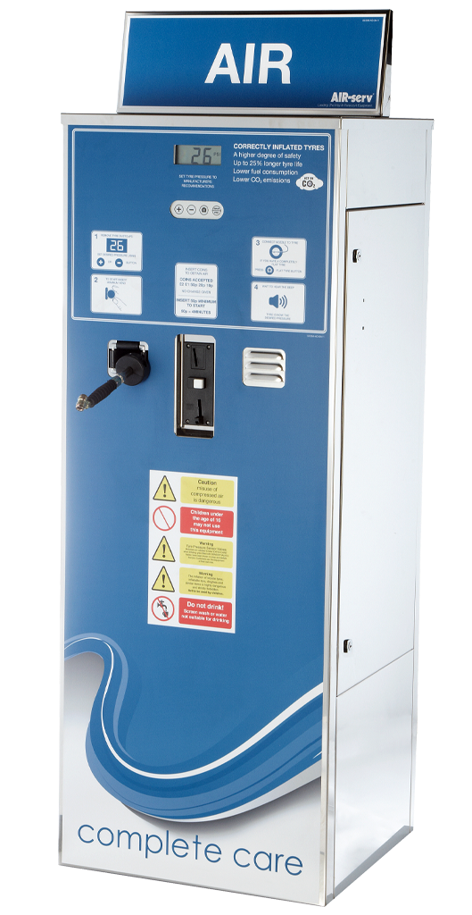
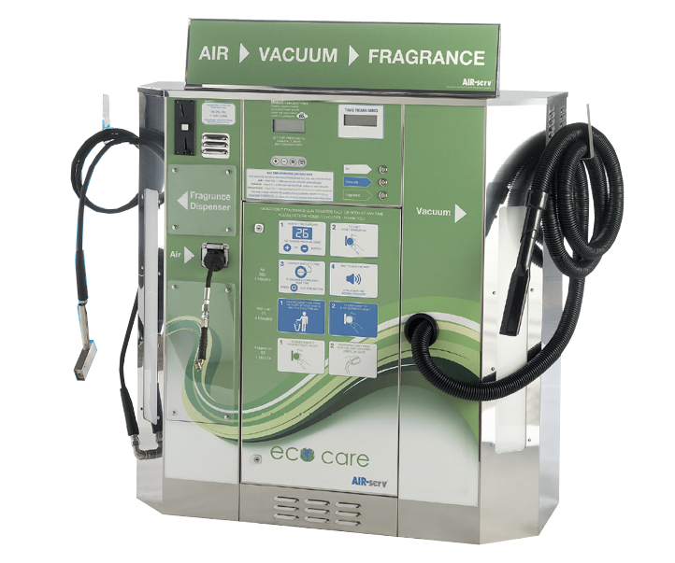
Private Capital
AIR-serv Europe: Leading designer, manufacturer and operator of air, vacuum and jet wash machines
Serves a large and embedded customer base of fuel station forecourt operators across the UK and Western Europe
Standard Air
Air, Vacuum & Fragrance
Twin Jet Wash
Deluxe Light Jet Wash
Strong market position and fundamentals
Opportunity for growth in existing markets and new geographies
Experienced industry operators Strong alignment of interest
Market leader in the supply of forecourt vending equipment Double digit growth in revenues and strong cash flow generation
Attractive underlying market
Well managed with strong alignment
Past performance is not a reliable indicator of future results
Caledonia financial information at 31 March 2025

Slide 10
Private Capital (cont’d)
AIR-serv Europe: continued strong performance since acquisition
Opportunity for growth in existing and new geographies
Cost (August 2023): £143m
31 March 2025 Value: £198m
(% NAV): 6.7%
IRR: 20.3%
HQ Wigan, Lancashire
Performance:
Continued to perform well, reporting good year-on-year growth and trading ahead of expectations
c.60% market share, with c.23,000 machines installed across c.15,000 customer locations
July 2024: Received first dividend of £6.2m
c. 220 employees
nine offices
Nine countries
c. 23,000
machines
Current coverage
Past performance is not a reliable indicator of future results
Caledonia financial information at 31 March 2025

Slide 11
KLH Capital
Tampa Florida-based, lower mid-market buyout manager
The US lower mid-market has been a core part of our investment strategy for the last 15 years and we have built a strong network of relationships over this time
Target company criteria
Enterprise Value: $20m to $125m
Revenue: $20m+ / EBITDA: $5m+
Total Equity Investment: $10m to $60m
8 - 12 platform investments per fund
1 - 3 platform investments per annum
Target investments
Typically first institutional capital into closely-held or family-owned business, who roll meaningful equity
Businesses with stable earnings, consistent profitability, a sustainable competitive advantage
Companies where KLH can improve operations post-transaction
Attractive valuations relative to investment risk
Overview
Founded in 2005, KLH Capital pursue value-oriented control investments in small companies in the specialty services, value-added distribution and niche manufacturing sectors across the US
We committed to KLH IV in 2019 and made a follow-on commitment to Fund V in 2022. We sit on the Advisory board for KLH IV and KLH V
Caledonia’s commitment
Fund Name | KLH IV | KLH V
Vintage Year | 2019 | 2023
Fund Size | $209m | $412m
Caledonia’s Commitment | $27.5m | $30m
Past performance is not a reliable indicator of future results
Caledonia financial information at 31 March 2025

Slide 12
KLH Capital
Tampa Florida-based, lower mid-market buyout manager
Portfolio Company Snapshots
Sub-sector Categories | Specialty Services & Value-Added Distribution | Specialty Services | Specialty Services | Specialty Services
Portfolio Company
Description | Leading supplier of petroleum fuelling and EV charging equipment, installation, and service across the US | Leading utility and infrastructure service provider to the telecom, power, gas, and other infrastructure markets | Specialty industrial services provider of recurring and re-occurring refractory, corrosion and scaffolding insulation and maintenance on mission critical equipment and piping | Leading field services provider of sawing, drilling, demolition, and concrete placement for the maintenance and retrofit of critical assets and infrastructure
Investment Date | February 2020 Sold in September 2022 | December 2020 | August 2022 | August 2023
No. of Add-Ons | 4 | 2 | 2 | 0
Value Creation | Develop and build out executive teams and middle management to support business scaling Enhance corporate infrastructure including IT, ERP systems and financial reporting Professionalise day-to-day operations and strategic planning Identify and execute strategic add-ons
Past performance is not a reliable indicator of future results
Caledonia financial information at 31 March 2025
1

Slide 13
Our strategy has driven long-term performance
Through a well-balanced diversified global portfolio of private and public companies
Public Companies (annualised)
Private Capital
(annualised)
Funds
(annualised)
Performance to 31 March 2025
(annualised)
Past performance is not a reliable indicator of future results
Caledonia financial information at 31 March 2025

Slide 14
Why Caledonia
Investing in high quality companies that have the potential to generate exceptional long-term value
A focus on ensuring shares remain attractive to a wide audience of investors
Providing shareholders with exposure to both listed and private markets through a diversified, global portfolio
Leveraging the expertise of our team of experts who are wholly aligned with shareholders
A long-term approach underpinned by an evergreen balance sheet
Investing alongside a multi-generational family office
Grow
Grow capital value and income over the longer term, NAVTR has grown by 9.0% p.a. over the last 10 years¹
£1,000 invested in Caledonia in 2015 would now be worth £2,069², including dividends
Pay
Dividend has increased each year for 58 years
Over the last 10 years, a shareholder with £1,000 invested would have received £380 in dividends³
Manage risk
Manage investment risk effectively for long-term wealth creation
A diversified portfolio of > 600 investments
Past performance is not a reliable indicator of future results
Caledonia financial information at 31 March 2025

Slide 15
© Caledonia Investments plc 2025. Caledonia Investments, Time Well Invested and the sealion guardant are registered trademarks.

